Slide 1

What is Marketing
Principles of Marketing
Notes:
All text in these slides is taken from https://courses.lumenlearning.com/waymakerintromarketingxmasterfall2016/, where it is published under one or more open licenses.
All images in these slides are attributed in the notes of the slide on which they appear and licensed as indicated.
Cover Image: No title Authored by: Nicolai Berntsen Located at: https://unsplash.com/photos/F3uyey6ours License: Creative Commons Zero

Slide 2
What is Marketing?
Marketing is a set of activities related to creating, communicating, delivering, and exchanging offerings that have value for others

Slide 3
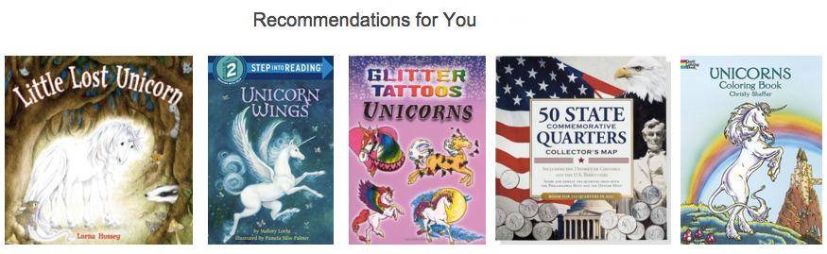
What is the function of marketing?
Marketing brings value to customers, whom the business seeks to identify, satisfy, and retain
Notes:
Screen shot of Amazon unicorn recommendations. Provided by: Lumen Learning. License: CC BY: Attribution

Slide 4
The Exchange Process
The act of obtaining a desired object from someone by offering something of value in return
Customer (or buyer)
Product
Provider (or seller)
Transaction

Slide 5
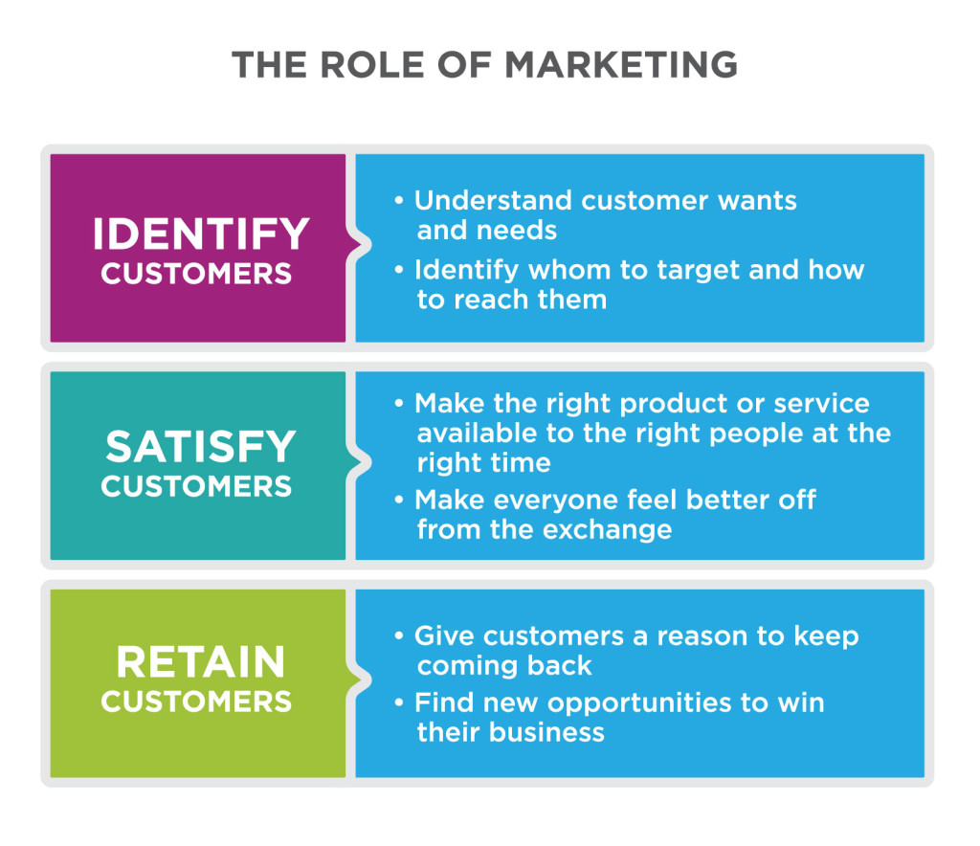
The Role of Marketing
Notes:
What Is Marketing?, Marketing Creates Value for Customers. Authored by: Lumen Learning. License: CC BY: Attribution

Slide 6
Marketing vs. Advertising
Advertising uses paid notices in different forms of media to draw public attention to a company, product, or message, usually for the purpose of selling products or services ^{[1]}
Advertising is one of many tools marketers use
Notes:
http://www.thefreedictionary.com/advertising ↵

Slide 7
Marketing vs. Branding
Branding is the process of “creating a unique name and image for a product in the consumer’s mind” ^{[2]}
Marketing builds brands, and branding is an important strategic consideration in marketing, but marketing is broader than branding
Notes:
http://www.businessdictionary.com/definition/branding.html) ↵

Slide 8
Marketing vs. Sales
Sales is the process of actually selling products or services
Effective marketing aligns well with the sales process and leads to increased sales, but there is more to marketing than just supporting sales

Slide 9
Company Orientations
The Marketing Concept | Success depends on doing better than competitors at understanding, creating, delivering, and communicating value to their target customers
The Product Concept | Success depends on creating the best, most innovative product for the lowest price
The Sales Concept | Success depends on a good sales team with the right tools and incentives.
The Production Concept | Success depends on low production costs, highly efficient processes, and mass distribution.
Notes:
The Marketing Concept
Success depends on doing better than competitors at understanding, creating, delivering, and communicating value to their target customers
The Product Concept
Success depends on creating the best, most innovative product for the lowest price
The Sales Concept
Success depends on a good sales team with the right tools and incentives.
The Production Concept
Success depends on low production costs, highly efficient processes, and mass distribution.

Slide 10
Relationship Stage and Typical Marketing Activities
Relationship Stage | Typical Marketing Activities
Meeting and Getting Acquainted | Find desirable target customers, including those likely to deliver a high customer lifetime value Understand what these customers want Build awareness and demand for what you offer Capture new business
Providing a Satisfying Experience | Measure and improve customer satisfaction Track how customers’ needs and wants evolve Develop customer confidence, trust, and goodwill Demonstrate and communicate competitive advantage Monitor and counter competitive forces
Sustain a Committed Relationship | Convert contacts into loyal repeat customers, rather than one-time customers Anticipate and respond to evolving needs Deepen relationships, expand reach of and reliance on what you offer

Slide 11

What is Customer Lifetime Value?
Customer lifetime value predicts how much profit the company will make from the customer during his or her lifetime relationship with the company ^{[1]}
Notes:
Lady on a Staircase. Authored by: torbakhopper. Located at: https://www.flickr.com/photos/gazeronly/10147130996/. License: CC BY-ND: Attribution-NoDerivatives

Slide 12
How Do Strong Customer Relationships Help a Business?
Happy customers
Return to buy more goods and services
Help market the business with positive reviews or word of mouth
Engage with the brand

Slide 13
Goals of Marketing
For profit companies:
Increase profits by selling products or services to customers
Not for profit organizations:
Promote the mission by attracting donors or participants or by raising awareness of an issue or cause

Slide 14
Difference Between
Customers and Consumers
Customers are the individuals who buy the product
Consumers are the individuals who actually use the product
The customer and the consumer are not always the same
Example: A food distributor’s customer is the restaurant, not the diner who is the consumer

Slide 15
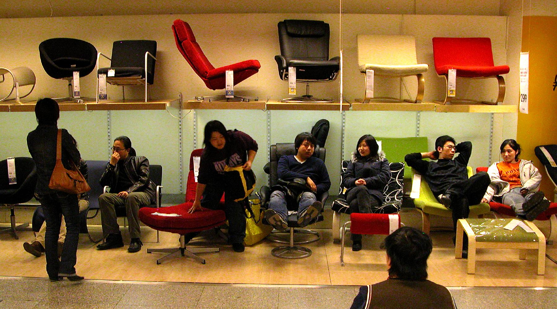
B2B vs. B2C
B2B or Business to Business companies sell products or services to other businesses
B2C or Business to Consumer companies sell directly to consumers
Notes:
IKEA, Bejing. Authored by: Peter Morgan. Located at: https://www.flickr.com/photos/pmorgan/5517848/. License: CC BY-NC-ND: Attribution-NonCommercial-NoDerivatives

Slide 16
Practice Question
Which type of business would benefit most from
Television advertisement
Trade show
Presentation at the rotary club
a) B2B b) B2C c) Dual focus

Slide 17
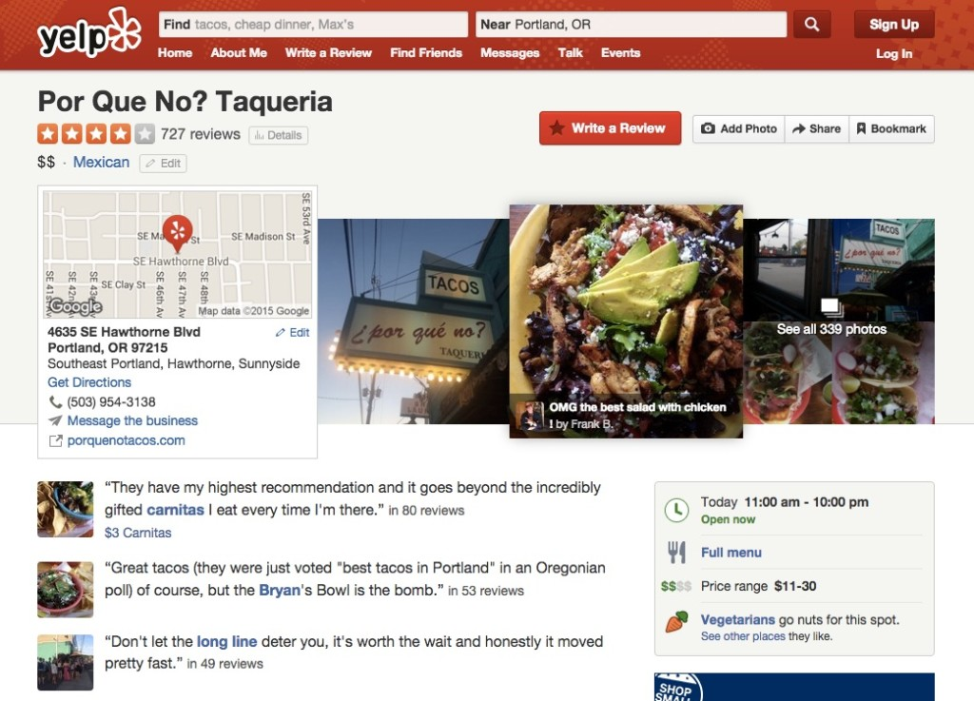
How does Marketing Serve Customers?
Marketing can help customers find goods and services that are valuable to them
Notes:
Screen Shot of Yelp Review. Provided by: Lumen Learning. License: CC BY: Attribution

Slide 18
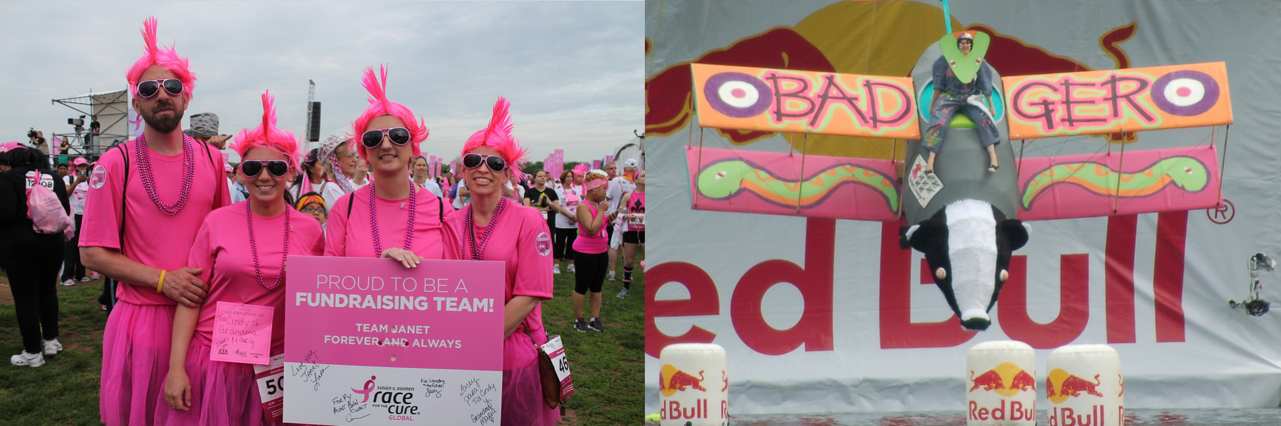
How Does Marketing Serve Society?
Marketing helps customers and businesses find each other to make exchanges that benefit them both
Marketing can spread ideas and innovation
Notes:
Global Race for the Cure. Authored by: Elvert Barnes. Located at: https://www.flickr.com/photos/perspective/13987275038/. License: CC BY-SA: Attribution-ShareAlike
Flugtag (22). Authored by: Helen Crook. Located at: https://www.flickr.com/photos/lalalen/2565923132/. License: CC BY-NC-ND: Attribution-NonCommercial-NoDerivatives

Slide 19
Quick Review
What is marketing?
Where do you experience marketing in everyday life?
What are the differences between marketing, branding, advertising, and sales?
What is the marketing concept? How does it differ from the production concept, the product concept, or the selling concept?

Slide 20
More Quick Review
What is the role of marketing in building and managing customer relationships
How do different types of organizations, such as non-profits, consumer product (B2C) firms and business-to-business (B2B) organizations, use marketing?
How does marketing create value for the consumer, the company, and society?

